Slide 1
MACHINE LEARNING PROJECT
GENDER PREDICTION WITH FIRST NAME
About the project
Introduction to the machine learning.
Models used in the machine learning.
Source of the dataset.
Front end technologies
  Html
  css
Back end technologies
  flask
Machine learning codes
Conclusion.

Slide 2
About the project
The project is all about the machine learning program which is written in the python for the predicting the probability of the person to male or female.
We have collected data of different players from various websites and done a lot of research.
The prediction is done on the basis of the first name given by the user.

Slide 3
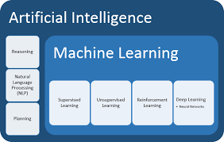
About machine learning
Machine learning is the scientific study of algorithms and statistical models that computer systems use to effectively perform a specific task without using explicit instructions, relying on patterns and inference instead. It is seen as a subset of artificial intelligence.

Slide 4
General Models used in this ML project.
Simple linear Regression model.
Multi linear Regression model.
Logistic Regression model.(This model is used in this project)
Python libraries like sklearn ,
numpy ,
pandas are used in this project.

Slide 5
Dataset collection / Source
The data is collected by us from the internet. There are various websites in the internet from where we have collected some data about the names of the people.
We have collected the data of names about 95000 for the accuracy of the model.
The model I have made is about 88 % accurate.
The data are in the .csv extension which is the format compatible for the excel sheet .

Slide 6
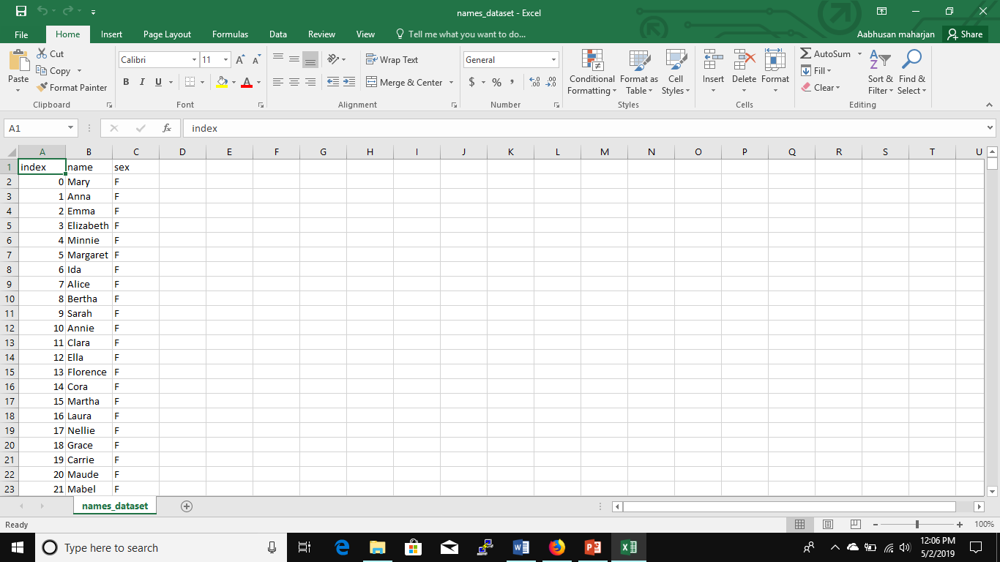
The data sample of names.csv

Slide 7

Front end technologies
There are several programming languages that can be used to write computer programs.
In this beginners course we will start with the basic front end languages which are HTML CSS and JAVASCRIPT. These three languages are collectively referred to as front end programming languages used to for web development and programming.

Slide 8
Frontend technologies
HTML
HTML stands for Hyper Text Markup Language. It is used to design web pages using markup language. HTML is the combination of Hypertext and Markup language. Hypertext defines the link between the web pages. Markup language is used to define the text document within tag which defines the structure of web pages. This language is used to annotate (make notes for the computer) text so that a machine can understand it and manipulate text accordingly. Most of markup (e.g. HTML) languages are human readable. Language uses tags to define what manipulation has to be done on the text.
HTML is a markup language which is used by the browser to manipulate text, images and other content to display it in required format. HTML was created by Tim Berners-Lee in 1991. The first ever version of HTML was HTML 1.0 but the first standard version was HTML 2.0 which was published in 1999.

Slide 9
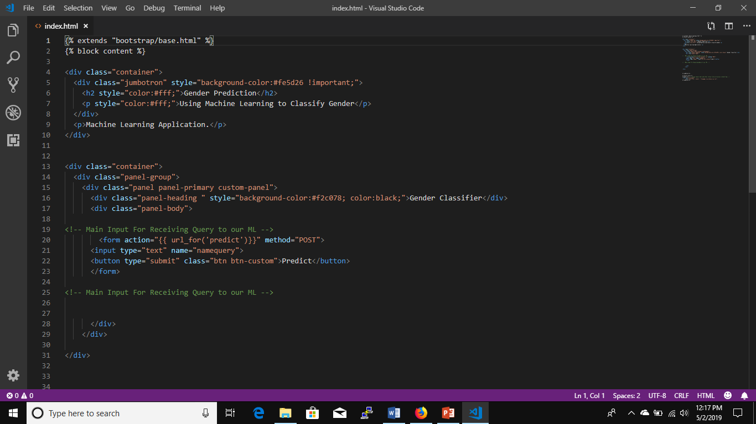
Index.html

Slide 10
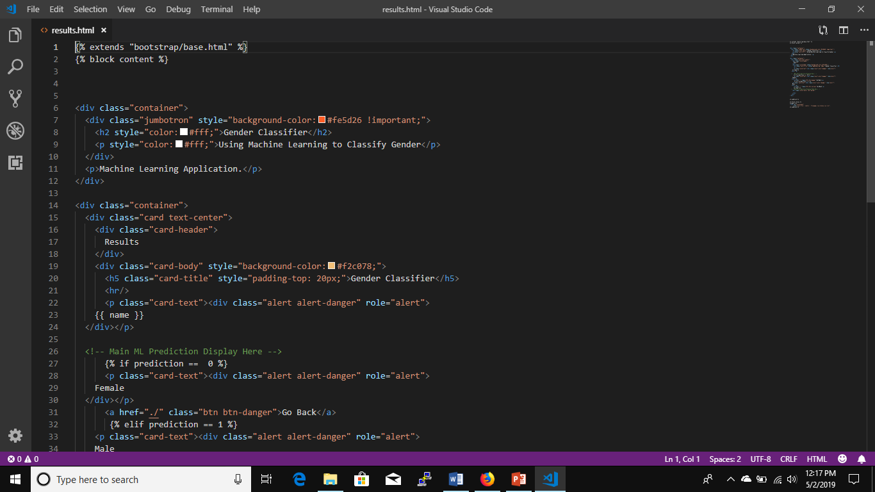
Result.html

Slide 11
Frontend technologies css
Cascading Style Sheets, fondly referred to as CSS, is a simply designed language intended to simplify the process of making web pages presentable. CSS allows you to apply styles to web pages. More importantly, CSS enables you to do this independent of the HTML that makes up each web page.
CSS is easy to learn and understood but it provides powerful control over the presentation of an HTML document

Slide 12
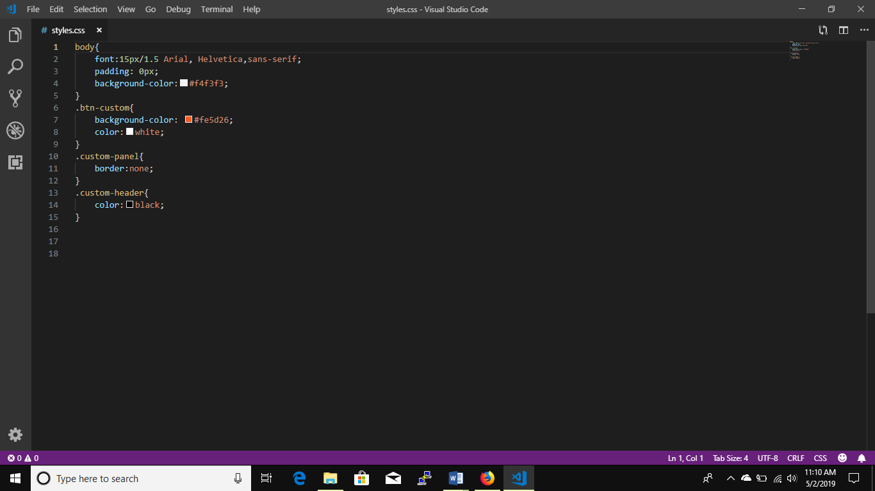
Css file

Slide 13
Backend technologies flask framework
Flask is a small and powerful web framework for Python. It's easy to learn and simple to use, enabling you to build your web app in a short amount of time.
In this article, I'll show you how to build a simple website, containing two static pages with a small amount of dynamic content. While Flask can be used for building complex, database-driven websites, starting with mostly static pages will be useful to introduce a workflow, which we can then generalize to make more complex pages in the future. Upon completion, you'll be able to use this sequence of steps to jumpstart your next Flask app.

Slide 14
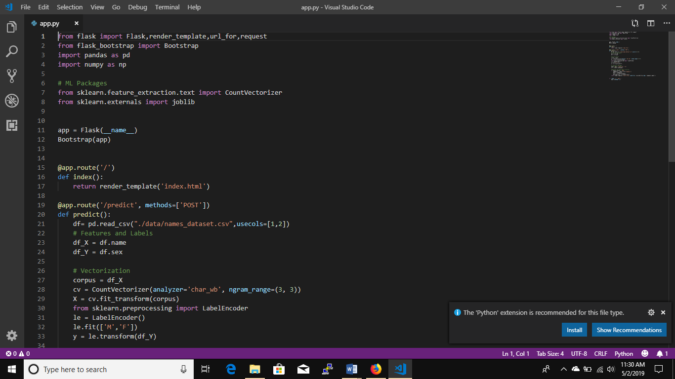
App.py written in flask

Slide 15
Machine learning codes.
The name of the machine learning code is actually gender prediction.py
It is written in python3 and I have used jupyter notebook as the code editor.
Various libraries are used for machine learning
Such as:
- Pandas
- sklearn
- Numpy

Slide 16
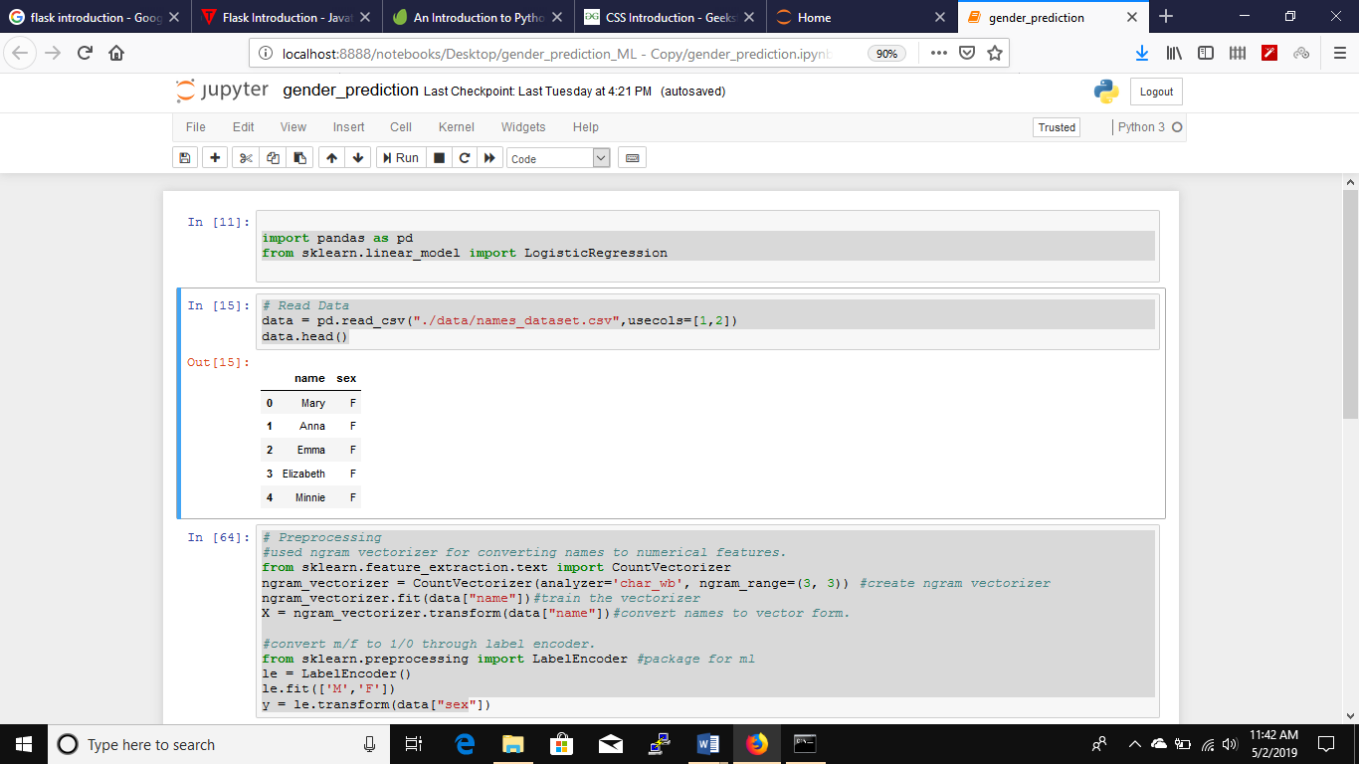
Gender_prediction.py

Slide 17
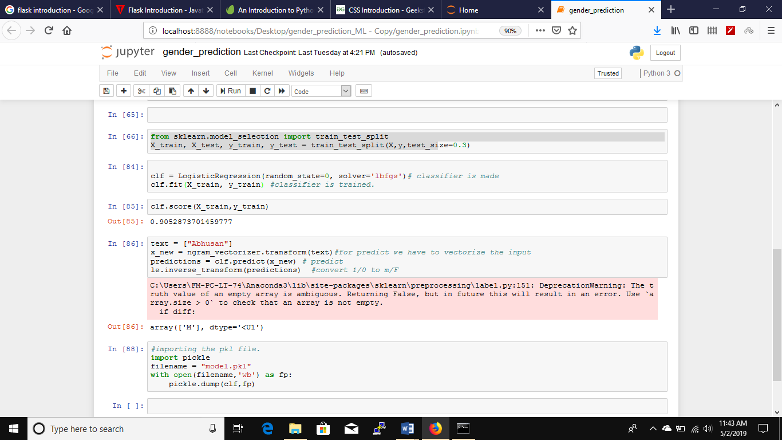

Slide 18
Conclusion
This is the project of the machine learning for the gender prediction
The prediction is done through the first name of the user
The name is given by user as input.
The model.pkl is the pkl model which is used in the app.py for the predicting the gender.
The model is 88% accuracy.
This percentage of the accuracy is very good.

